Slide 1

Truthy
Abdi J, Atour M G, Ioana M, Gabriel T

Slide 2
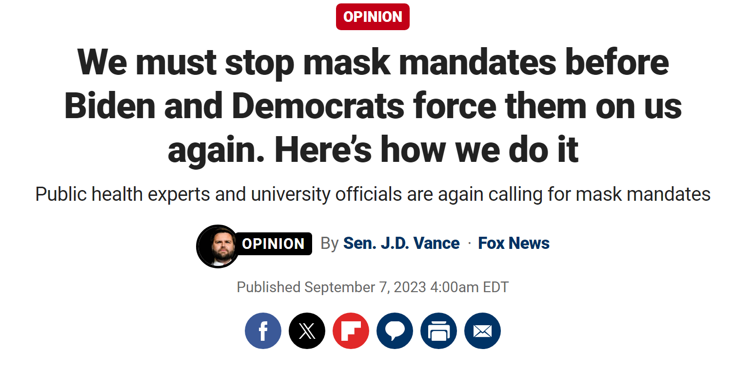
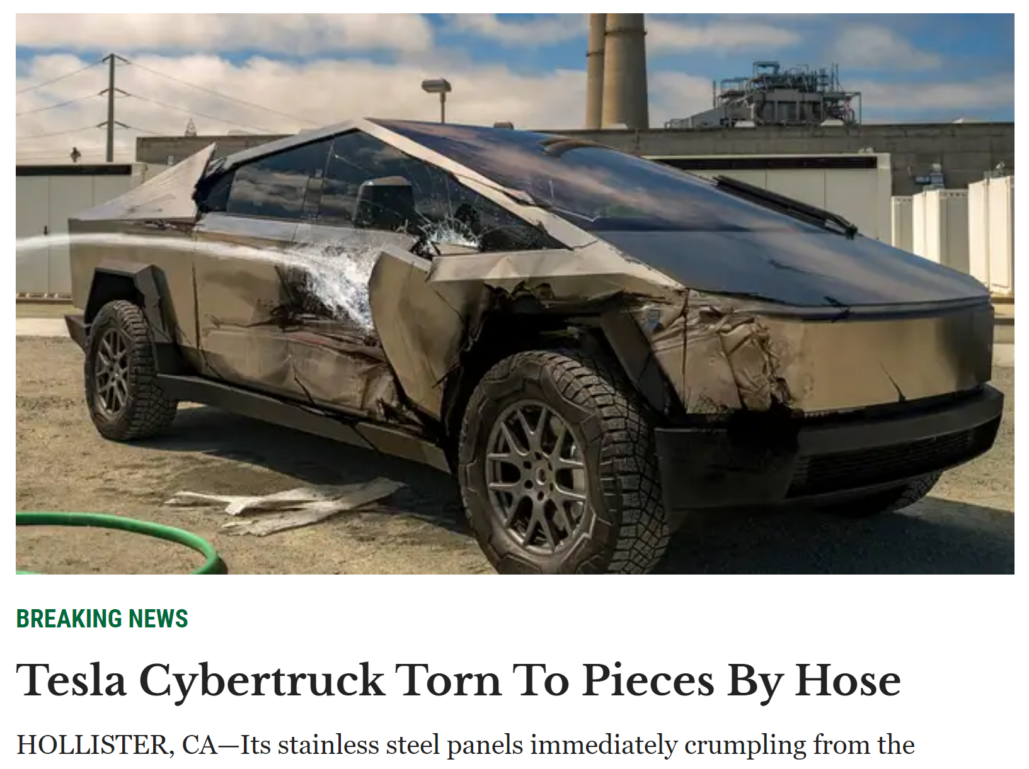

Slide 3

Frontier systems may amplify risks such as disinformation.

Slide 4

Frontier systems may amplify risks such as disinformation.

Slide 5
COVID cases are spiking, and the American people urgently need to mask up. Is anyone surprised?
We all know that vaccines cause autism. Don’t let the government fool you
Synthetic example

Slide 6
COVID cases are spiking, and the American people urgently need to mask up. Is anyone surprised?
We all know that vaccines cause autism. Don’t let the government fool you
Synthetic example

Slide 7

Track the amount of misinformation
politicians and authors
Accountable
Political Bias
Agenda
Bringing this all together
Help make web safer
Tackle main issues raised Global AI Safety Summit

Slide 8
Truthy

Slide 9
Truthy

Slide 11
